Slide 1
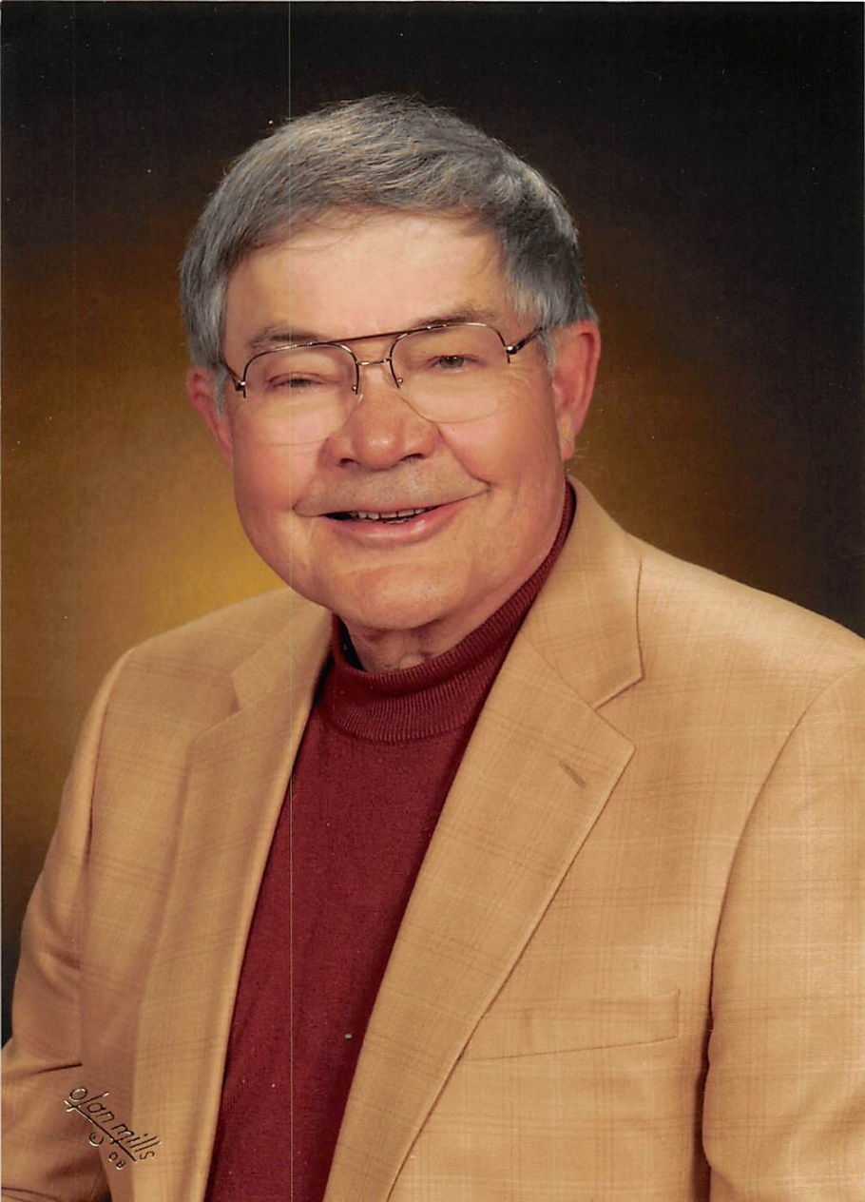
Donald T. Reay, MD
Explanation: Dr. Reay was my esteemed mentor, Past President of NAME, and winner of the Helpern Award in 2015. Upon his death in November 2018, his family gifted some of his personal papers to me, and to Dr. John Howard, my partner in Spokane. Included among the papers were several Kodachrome slide presentations. In looking at the presentations, it occurred to me that his lecture on court testimony was still as pertinent today. I have no knowledge of when or why he originally gave this presentation. I have copied the slides verbatim. Sally S. Aiken, MD 2019

Slide 2
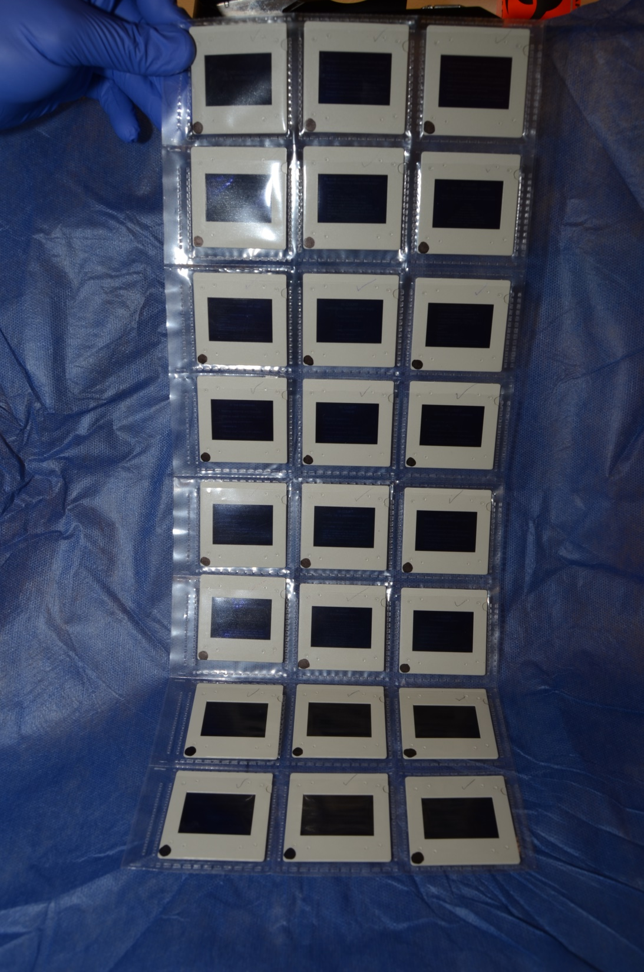
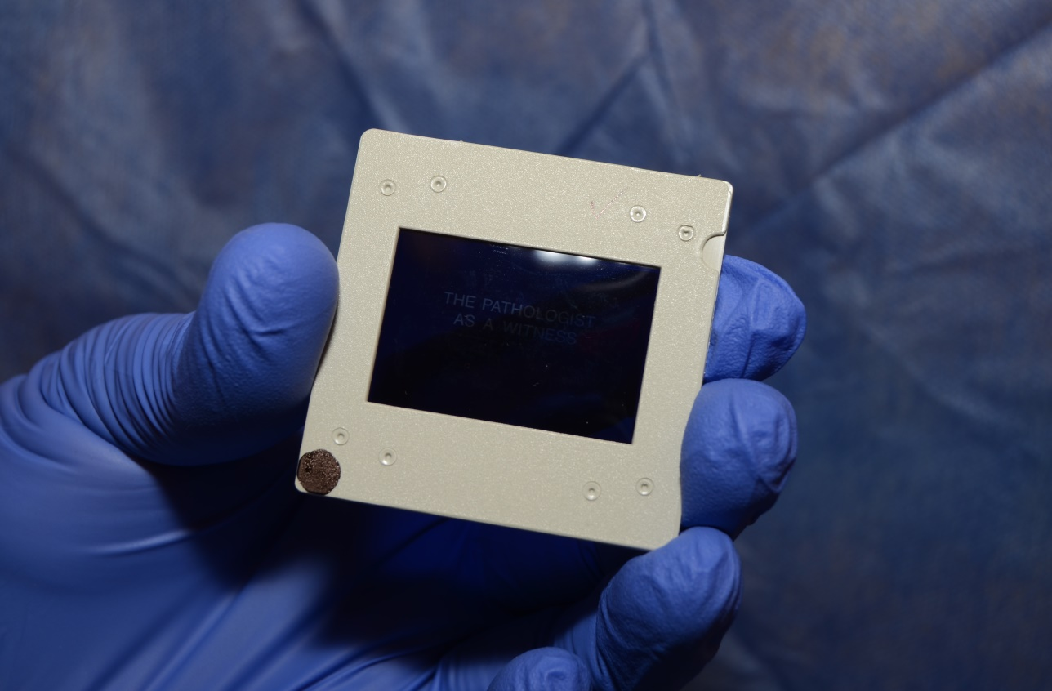
The original presentation

Slide 3
The Pathologist as a Witness
Donald T. Reay, MD

Slide 4
Physicians are frequently called upon to testify
It’s more a matter of when you will be called, not if you will be called
It is easy to testify once you are familiar with the basic sequence and know the rules
You should accompany an experienced witness on several occasions to see how it is done
Thorough preparation before your first few trials should prevent unfavorable experiences

Slide 5
In the adversarial system, each side puts on its best performance
Trial before the Court versus trial before the Jury
Jury (selection and screening, size, function, educational level, general working guidelines)
The judge ensures that the trial is conducted properly, according to the rules
Expert witness vs Fact Witness (Expert witnesses are allowed to include opinions and conclusions

Slide 6
As soon as you know you are needed record necessary basic information
Name of the victim or deceased
Case and chart number
Style of the case
Jurisdiction and Court location
Which attorney is calling you
Which side the attorney represents
Address, phone and FAX numbers of attorney
The name of opposing council
General nature of the proceeding
When and how to get there and parking

Slide 7
As soon as you know you are needed record necessary basic information
(Continued)
Who will pay you for your time
What to bring with you
The general nature of the case
Specific items of interest or dispute
What to do if contacted by the other side
When the pretrial meeting will be held
Arrange for final confirmation of plans, etc.

Slide 8

In court a “kit” of reference material
Make a small folder to suit your personal needs. The content will vary with experience and interest.
Pointer
Calculator
Blood volumes
Conversion factors
Normal Organ Weights
Height and Weight of Children
Widmark-type body water values
Selected data for drugs and alcohol
Etc.

Slide 9
In Court definitions, medical and legal
cause
Manner
Proximate, initiating, moving, primary
Intermediate
Immediate
(Intervening)
The circumstances, 5 possibilities
Natural, Accident, Homicide, Suicide, Undetermined
MECHANISM
Disturbances/Malfunction initiated by the cause
Usually do not belong on the death certificate

Slide 10
In Court
Definitions, Medical and Legal
Intoxicated vs. “drunk”
Under the influence
Drug
Controlled substance
Deadly weapon
Driving or operating

Slide 11
BEYOND A REASONABLE DOUBT—important in criminal cases
REASONABLE MEDICAL CERTAINTY—best way to explain the observed facts
REASONABLE MEDICAL PROBABILITY—excellent explanation but others might differ
PROBABLE—likely
POSSIBLE—may be, but not likely
SPECULATIVE—given a set of facts, you could hypothesize until tired but still not come to a conclusion

Slide 12
At the Courthouse
Waiting, watching, and listening
Who to avoid; what not to discuss
Entering the Courtroom
Swearing in
Stating your name and address
Qualification as an expert

Slide 13
In Court
General
Personal appearance
How to sit and behave
Whom to look at and address
Organize and know your material
How to address the various participants (judge, attorneys, jurors, reporter, etc.)

Slide 14
In Court
Questions and Answers
Listen to the question
Take time to think
Answer clearly, audibly, and firmly
If someone objects, await the outcome
Be courteous, reasonable, and calm (Never allow an attorney to provoke you)

Slide 15
In Court
Questions and Answers
Stay within your field of expertise
Avoid exaggeration
Do not volunteer information (until you have many years of experience)
Be prepared to say you don’t know, or can’t tell
Every question is not a trick (most are not)

Slide 16
In Court
Testify on a professional level
Be clear and follow a logical sequence
Use familiar units (inches to most jurors)
Avoid unnecessary use of medical terms, but if a medical term is required use the lay term followed by the medical (This avoids “talking down” to the jury.)
Part of your function is to “teach” the jury

Slide 17
In Court
Testify on a Professional Level
Testify only to what you know
Concede points that should be conceded
Answer all questions openly and honestly
Don’t be afraid to use simple logic and straightforward explanations
Your right to qualify answers and not be limited to “yes” or “no”

Slide 18
In Court
Testify on a professional level
Remain calm, never get excited, and always try to maintain a constant/even demeanor
Don’t be afraid to show some emotion should something funny occur (you appear human)
Create the best possible impression
You are not an advocate or on either “side” (you are there simply to present facts and state expert conclusions to assist the court)

Slide 19
In Court
Miscellaneous items
Introducing the autopsy report or records
Business records act or local equivalent
Introduction of photographs
Routine course of business
Made by someone with personal knowledge
At or about the time of event
In the routine course of business
Care and custody of records
Color vs. black and white
“Fair and accurate representation”
Qualified reply if partly covered up

Slide 20
In Court
Miscellaneous Items
Hypothetical questions
Familiarity with standards of care
Informed consent
Negligent misrepresentation
Captain of the ship doctrine
Res Ipsa Loquitur (The thing speaks for itself)

Slide 21
In court trick questions and problem areas
“Are you being paid for your testimony?”
Authoritative Books and Articles
Playing your deposition against your testimony
Quoting something you never said
Drawing you away from the jury
Multi-part questions

Slide 22
In Court
Trick questions and problem areas
“Have you talked with anyone about this case?”
“Have you ever made a mistake?”
“Do you want this jury to understand?” (Beware!)
“I’m just a country lawyer!” (Like a fox!)
Combined effects of multiple drugs
“When the bullets were aimed at the heart….?” (You don’t know where they were aimed, nor does he)

Slide 23
In court trick questions and problem areas
“You haven’t been a doctor very long, have you?” (Reply how long and what you have done; not “No”)
An attorney tries to get you to adopt his style (loud, fast, slow, confused, argumentative, etc.)
Deliberately reverses your numbers or words
Repeats questions but a little differently each time
Stares, as if expecting additional information or some qualification or amendment to your reply

Slide 24
In Court
Counter tactics (when Experienced)
“You seem to be having difficulty, may I assist you?”
Smile when he gets all hot under the collar
Answer with slight hesitancy when he enters an area in which you have particular interest and knowledge (so attorney zooms in, only to hit concrete wall)
When attorney tries to gloss over a point you indicate “it’s important for the jury to understand”

Slide 25
In court counter tactics (when experienced)
Encourage the attorney to ask a question which he “doesn’t know the answer to” so that you can counter with unexpected depth of knowledge and day-to-day familiarity
Suddenly produce an unexpected or unwelcome fact or observation relating to a subject area which the attorney is doing his best to avoid

Slide 26
In court counter tactics (when experienced)
Keep things strictly in the context of the case
Detect basic “high school level” errors in a simple statement of fact, thus making him look idiotic
Q: “Doctor do you mean to say that if I were to lie on the floor you could kick me in the face?”
A: “Certainly if you were equally intoxicated and had your head between the commode and bathtub”
S: “It would have taken him about half a second to fall 17 feet from the roof to the concrete floor”
A: “No sir, about one second, and the floor was wood”

